Slide 1
Urban Rabies ABM- Draft Figures

Slide 2
Questions
Can rabies be eliminated from urban landscapes at seroprevalence rates less than 60%?
Which management/ecological factors influence probability of rabies elimination and re-invasion?

Slide 3
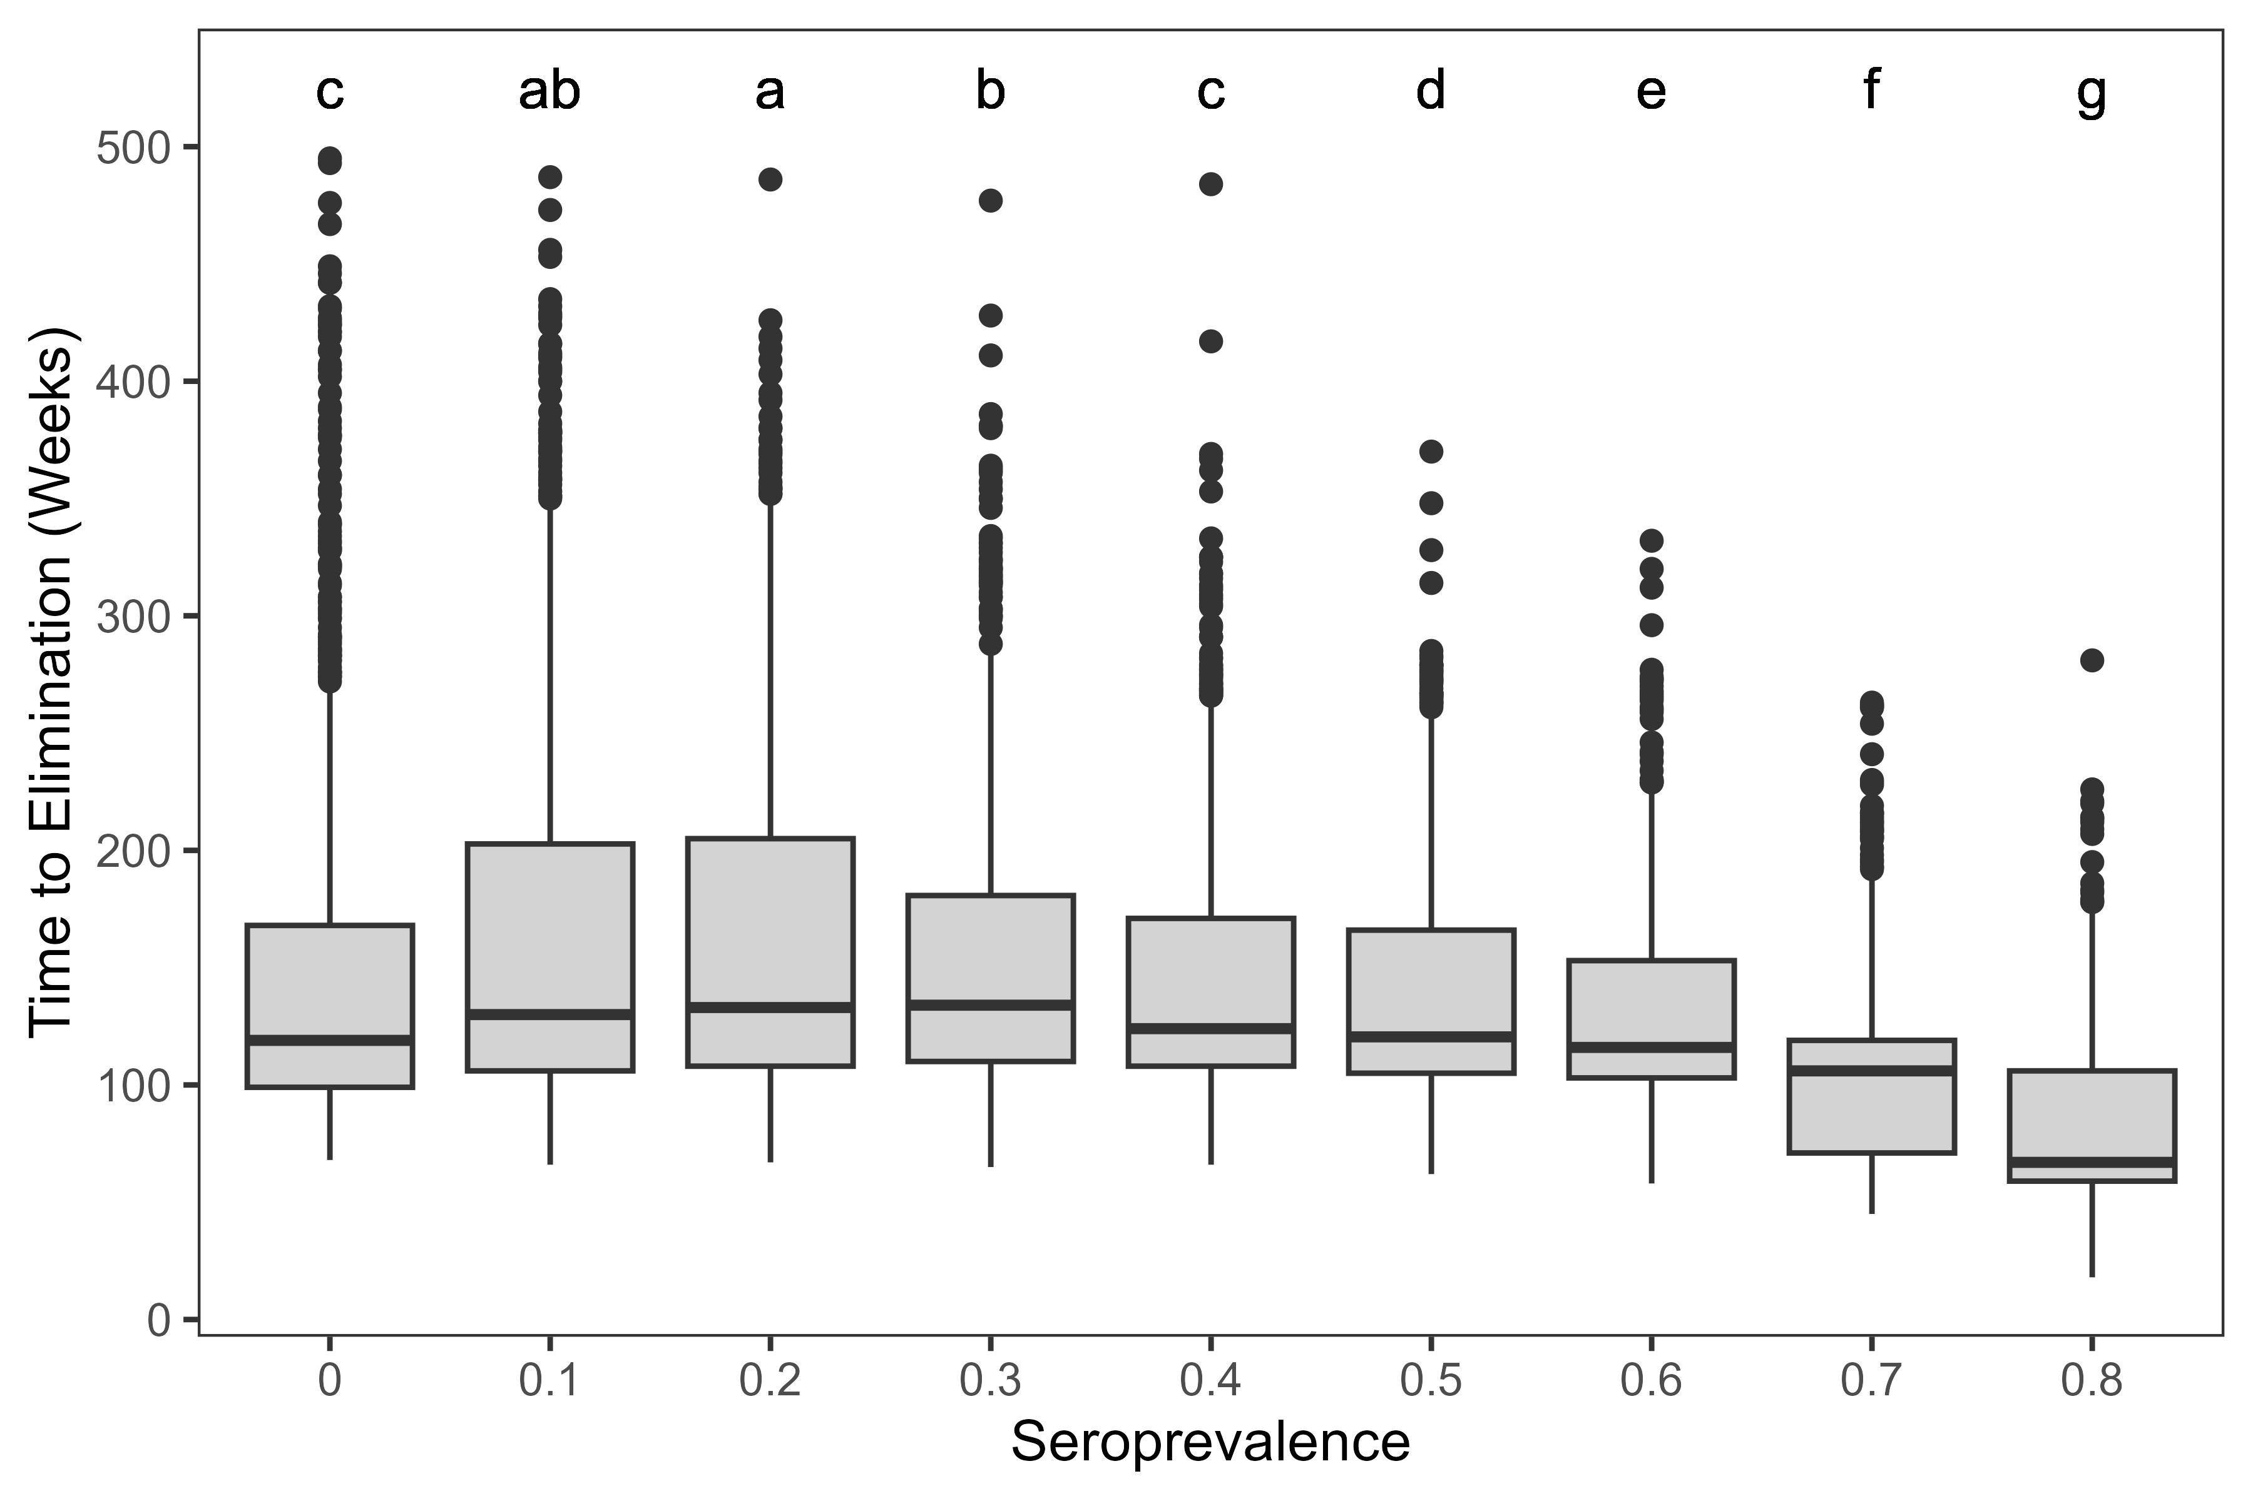
Rabies is usually eliminated in 10 year period, regardless of seroprevalence

Slide 4
Need 50% seroprevalence to see improvements over no management

Slide 5
Seroprevalence 10-30% leads to longer time to elimination than doing nothing

Slide 6
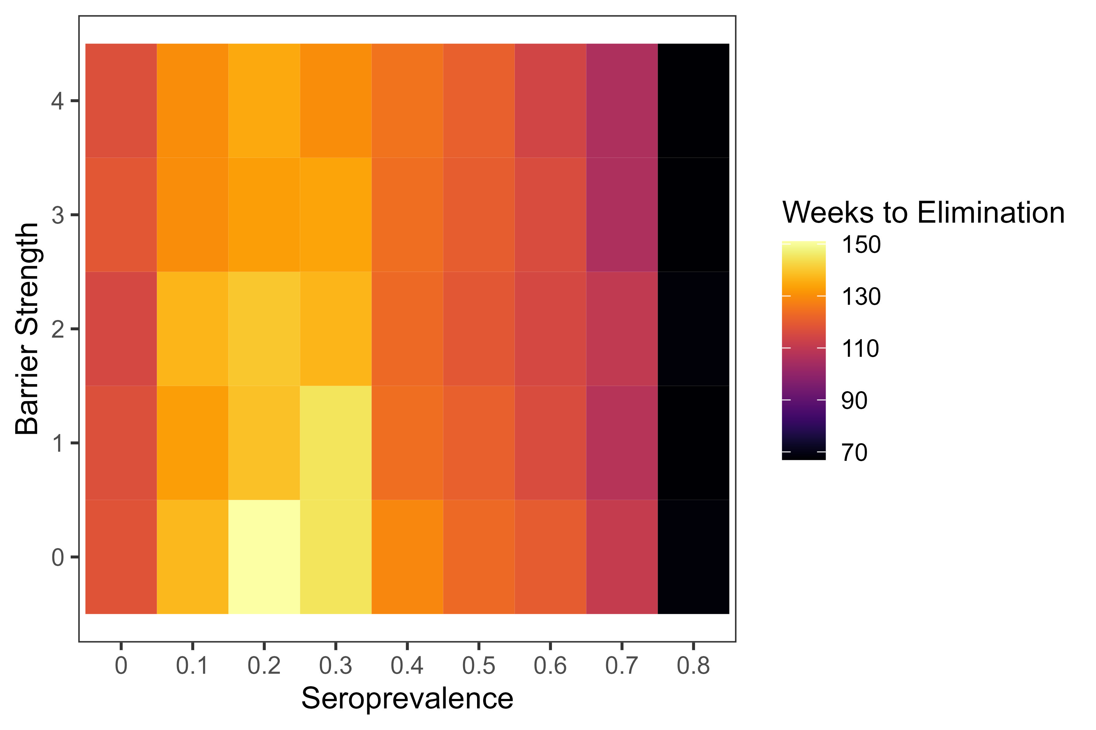
Landscape barriers have small effect at low seroprevalence rates

Slide 7
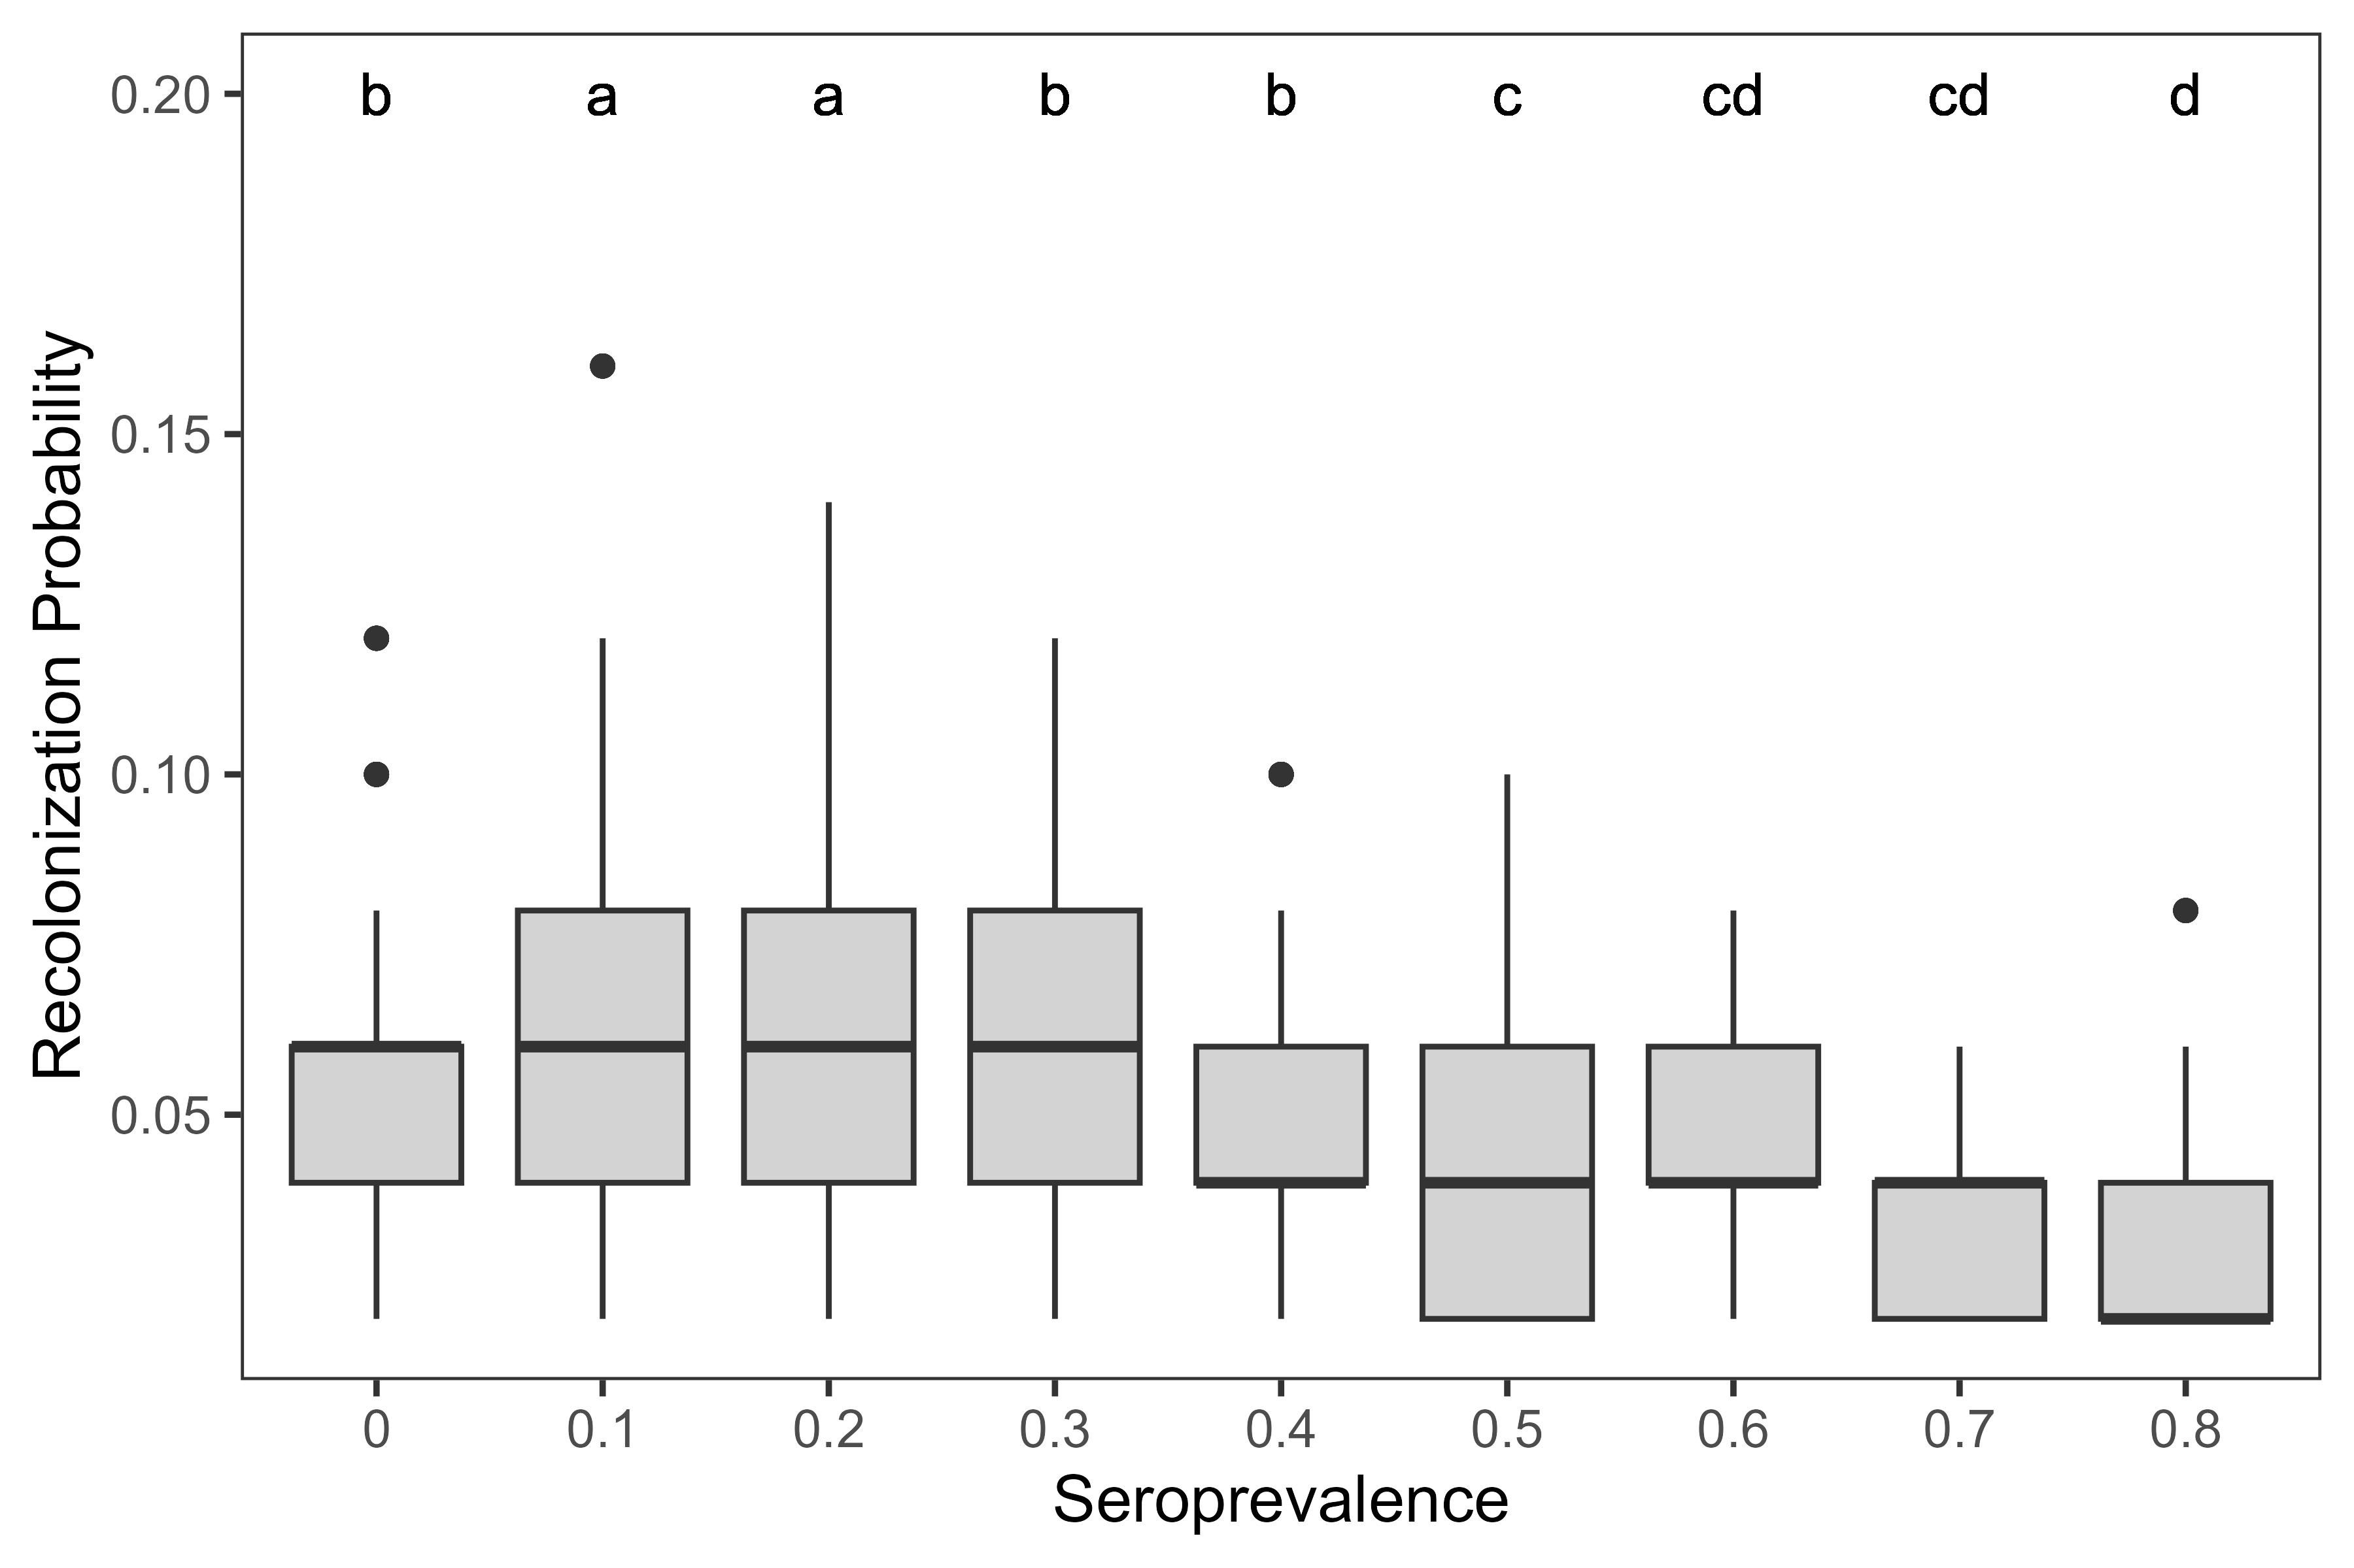
50% seroprevalence is also where we see lower probs of reinvasion

Slide 8
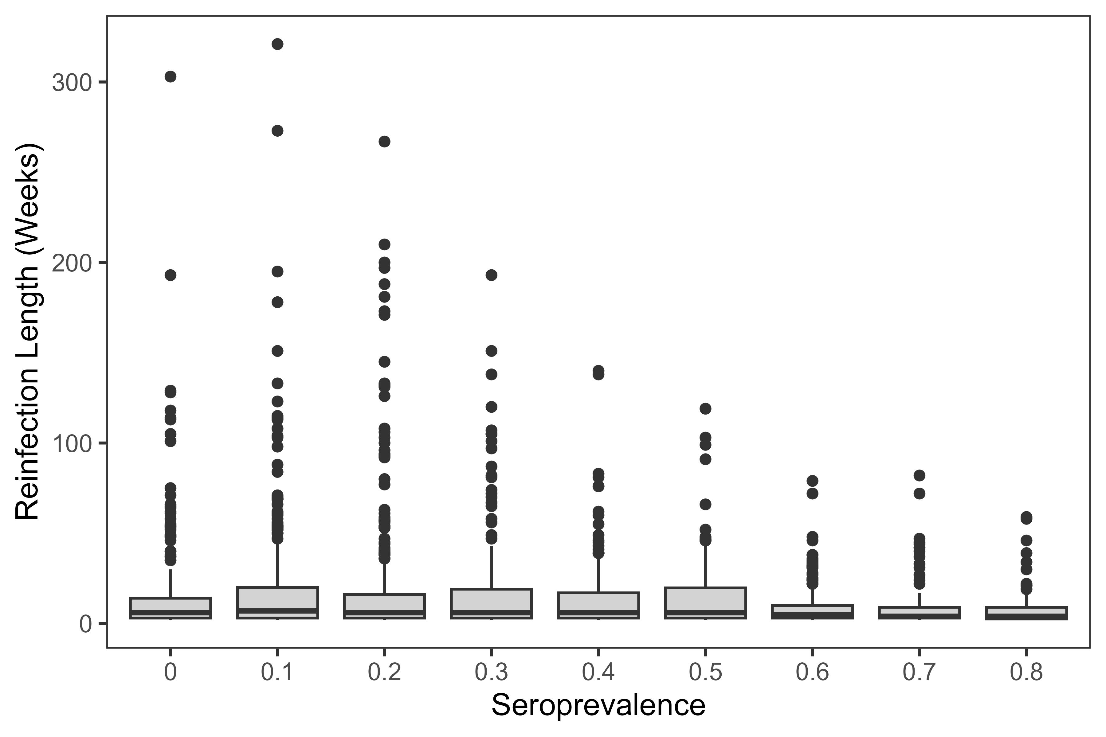
Need to do a quantile regression, but lower sero values might lead to longer reinfection periods

Slide 9
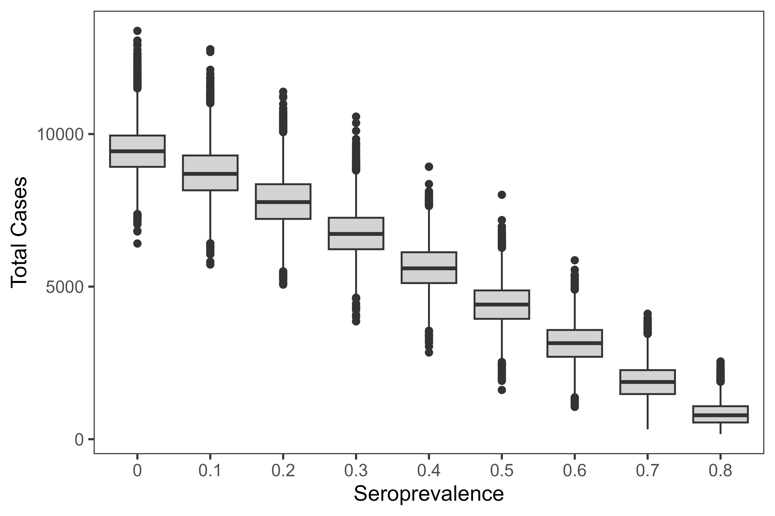
Every increase in seroprevalence = reduction in cases (and overall prevalence)

Slide 10
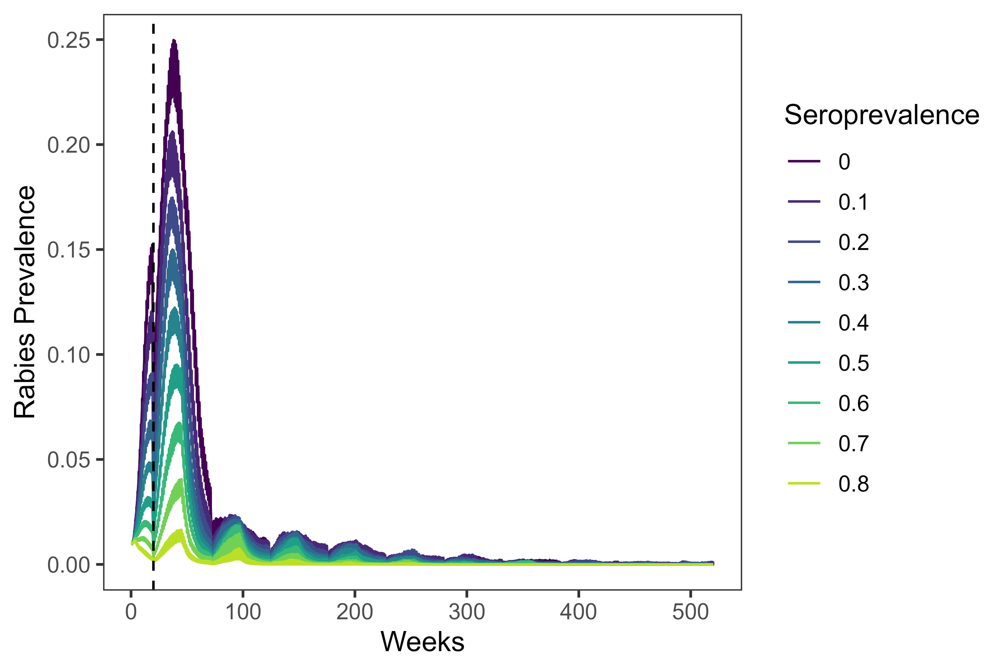
Prevalence and n cases drop after huge initial spike

Slide 11
Birth pulses also lead to a spike in cases/prevalence

Slide 12
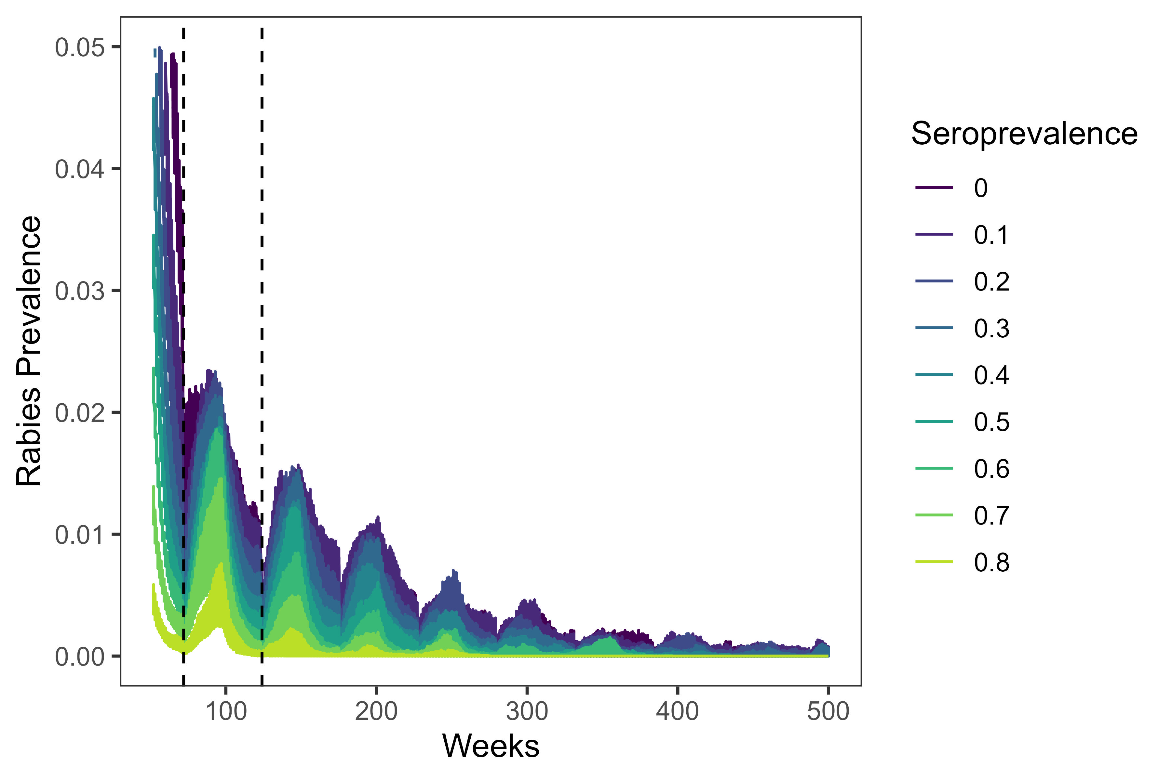
Birth pulses (dashed) lead to additional pulses after initial spike

Slide 13
Conclusions
Rabies was eliminated in all but 1 replicate
50% seroprevalence or higher reduces time to first infection & probability of reinvasion

Slide 14
Conclusions
Seroprevalence of 10-30% leads to longer time to elimination, greater chance of reinfection than doing nothing
Why? Because with 0% seroprevalence, almost everyone dies. 10-30% leaves more survivors for the next birth pulse

Slide 15
Conclusions
Any increase in seroprevalence leads to case reductions
Birth pulses matter quite a bit
Management recommendations?
Seasonality of the bait drop to vaccinate juveniles probably matters a lot
Target seroprevalence depends on goals and resources available- based on these results, 60% seems a bit arbitrary

